Slide 1
Noise Pollution Monitoring
System
VIDHYASAGAR.K
SASIKANNAN.S
NAVEEN KUMAR.S
ARUN.C

Slide 2
COMPONENTS
Introduction
System Module And Assumptions
Block Diagram
System Architecture
Algorithm
Program
Working Of The Project
Literature Survey
Result
Conclusion

Slide 3
Introduction
In this era of modernization, technologies are making rapid progress.
A day we feel some new technology coming in market to simplify our lives .
Back in time checking the pollution during a particular frequency was a really tedious task which wasn’t very efficient although.
With rapidly increasing pollution and rapidly advancing technology various new methods were also introduced to stay and fix the rapid increase in polluted area by skill full activies.
Only internet of things is one among the newest works that has been wiped out this path.
The increment in use of internet and therefore the interaction of living one’s with the machine gave rise to IOT.

Slide 4
System Module And Assumptions
Tier1 provides knowledge of the parameters under the region which is to monitor for noise and something control.
Tier 2 deals with sensor device with suitable characteristics, features and every single sensor are operated and hold their sensitivity also because if the area of sensing.
In b/w tier 2 and tier 3 obligatory sensing and controlling actions are going to be taken depending upon the drastic conditions, like fixing the edge value , periodicity of sensing, messages (buzzer or alarm) etc.
Based on the data interpretation performed b/w tier 2 and tier 3 and from previous groundings the parameter threshold values during normal working conditions that are determined.
Tier 3 tell us about the data acquisition from sensor devices and includes the decision making. Which specially specify the condition that the data is representing which parameter .
In the proposed tier 4 deals with the intelligent atmosphere.

Slide 5
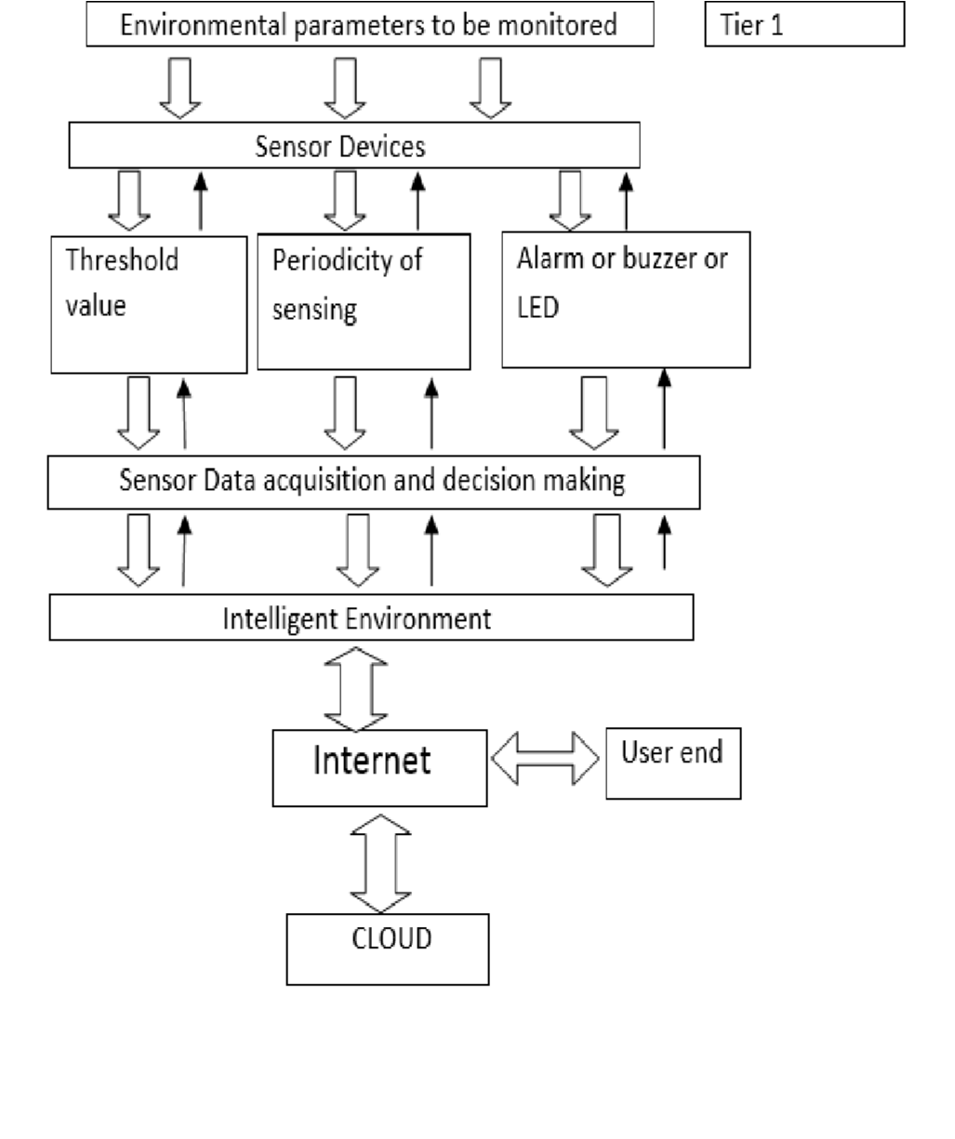

Slide 6
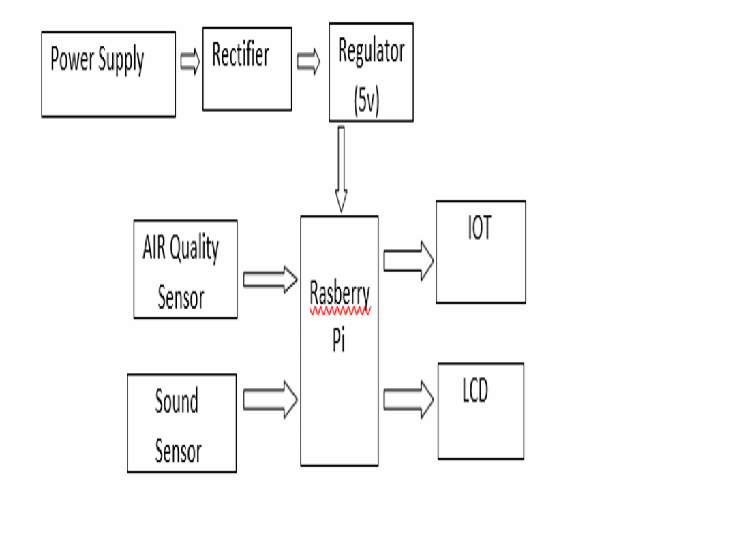
Block Diagram

Slide 7
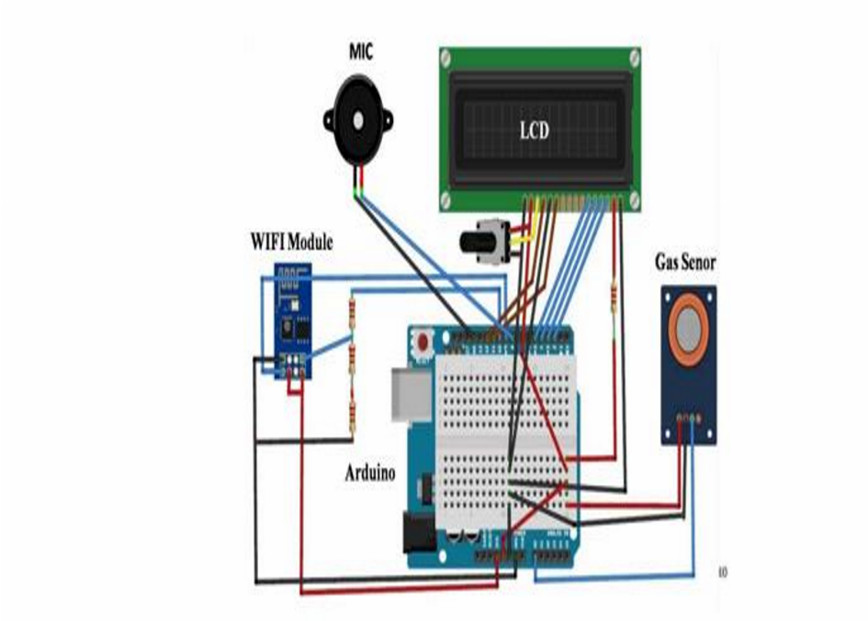
System Architecture

Slide 8
Algorithm
A decision tree may be a flowchart-like structure during which each internal node represents a “test” on an attribute (e.g. whether a coin flip comes up heads or tails), each branch represents the result of the test, and every leaf node represents a category label (decision taken after computing all attributes).
The paths from root to leaf represent us about classification of rules.
In decision we survey, a choice tree and therefore the closely related influence diagram are used as a visible and analytical decision support tool, where the expected values (or expected utility) of competing alternatives are calculated.
A choice tree consists of three sorts of nodes: Decision nodes typically represented by squares Chance nodes typically represented by circles End nodes typically represented by triangles Decision trees are commonly utilized in research and operations management.
In practice, decisions need to be taken online with no recall under incomplete knowledge, a choice tree should be paralleled by a probability model as a most suitable option model or online selection model algorithm.

Slide 9
Program
#include <iostream> #include <vector> #include <fstream> #include <portaudio.h>
// The callback function to process audio data
static int audioCallback(const void *inputBuffer, void *outputBuffer,
unsigned long framesPerBuffer,
const PaStreamCallbackTimeInfo *timeInfo,
PaStreamCallbackFlags statusFlags,
void *userData) {
// Cast the input buffer to a float array
const float *in = static_cast<const float*>(inputBuffer);
// Calculate the RMS (Root Mean Square) of the audio data as a noise level indicator
double rms = 0.0;
for (unsigned int i = 0; i < framesPerBuffer; i++) {
rms += in[i] * in[i];

Slide 10
}
rms = std::sqrt(rms / framesPerBuffer);
// Open and append the RMS value to a log file std::ofstream logFile("noise_data.txt", std::ios::app); logFile << "RMS: " << rms << std::endl;
return paContinue;
}
int main() { // Initialize PortAudio
PaError err;
err = Pa_Initialize();
if (err != paNoError) {
std::cerr << "PortAudio error: " << Pa_GetErrorText(err) << std::endl;
return 1;
}
// Configure audio input parameters PaStream *stream;
PaStreamParameters inputParams;
inputParams.device = Pa_GetDefaultInputDevice(); // Use the default input device

Slide 11
inputParams.channelCount = 1; // Mono audio inputParams.sampleFormat = paFloat32; // 32-bit floating-point
inputParams.suggestedLatency = Pa_GetDeviceInfo(inputParams.device)->defaultLowInputLatency;
inputParams.hostApiSpecificStreamInfo = nullptr;
// Open the audio stream
err = Pa_OpenStream(&stream, &inputParams, nullptr, 44100, 256, paClipOff, audio);
if (err != paNoError) {
std::cerr << "PortAudio error: " << Pa_GetErrorText(err) << std::endl;
return 1;
}
// Start the audio stream
err = Pa_StartStream(stream);
if (err != paNoError) {
std::cerr << "PortAudio error: " << Pa_GetErrorText(err) << std::endl;
return 1;
}
std::cout << "Recording noise data. Press Enter to stop..." << std::endl; std::cin.get(); // Wait for Enter key press

Slide 12
// Stop and close the audio stream
err = Pa_StopStream(stream);
if (err != paNoError) {
std::cerr << "PortAudio error: " << Pa_GetErrorText(err) << std::endl;
}
err = Pa_CloseStream(stream);
if (err != paNoError) {
std::cerr << "PortAudio error: " << Pa_GetErrorText(err) << std::endl;
}
// Terminate PortAudio
Pa_Terminate();
return 0;
}

Slide 13
Working Of The Project
Here we propose an air and also noise pollution quality monitoring system that permits/ allow us to check and watch air quality also as noise pollution in an area through IOT.
System uses air sensor to sense presence of harmful gases / compounds within the air and constantly transmit that data to the user. Also, system keeps measuring sound level and report the data immediately.
The sensors interact with raspberry pi which processes this data and transmits it over the appliance. This allows us the authorities to watch pollution in several areas and act against it.
Also, same for sound pollution authorities can keep a watch on sound pollution near traffic and no honking areas. Network devices and therefore the internet of things (IOT) all types of ordinary house gadgets are almost modified to figure in an IOT system.
Wi –Fi network adapters , cameras , microphones and other instrumentation are often embedded in such kind of devices to enable them for addition of IOT.

Slide 14
Literature Survey
The motive of creating a sensible city are often fulfilled by using technology, thus making the life better and also enhancing the quality of services, therefore meeting every individual's needs.
With modern technology in fields of information and communication, it has become easy to interact with the authorized people of the city to inform the whereabouts of the world or city, how well the town is developing, and how to make it possible to achieve a better life quality. In this system, an application was created to make one more step in the fulfillment of the goal.
An area is analyzed for evaluating how much pollution is affecting the area. The components of gases and their amounts are calculated and checked.
If the amount is higher than normal then the officials are reported about it.
After that, the people are made to clear the area and taken to a safe place.
The combined network architecture and the interconnecting mechanisms for the accurate estimation of parameters by sensors are being explained and delivery of data through internet is presented.

Slide 15
Result
The air and sound pollution monitoring system monitors air and noise pollution by employing a mobile application.
It shows the digital value of air and noise pollution and the user can analyze it with a graph. It becomes very easy for us to rectify the amount and air and sound pollution around and plan for healthy living and surroundings.
The figures that are included in our paper shows the way the system works and the way the output is obtained from the input after processing.

Slide 16
Conclusion
The Automatic Air & Sound management system may be a breakthrough to contribute an answer to the most important threat.
The air & sound monitoring system overcomes the matter of the highly-polluted areas which may be a major issue. It supports new technology and effectively supports a healthy life concept.
This system has features for the people to watch the quantity of pollution on their mobile phones using the appliance. So, it becomes very reliable and efficient for the Municipal officials alongside the Civilians to watch the environment.
Letting civilians also involved in this process adds an extra value to it. As civilians are now equally aware and interested in their environment, this idea of IoT is useful for the welfare of society. And it is implemented using the latest technology.

Slide 17
THANK YOU

